Slide 1

Introduction to IT infrastructure and Landscape (CSIT1001)

Slide 2
Unit-I (Syllabus)
Understanding datatypes and characteristics.
Data warehouse and data marts, Data mining.
What is information Technology (IT),Open Standards.
Storage Network Technology., Types of Storage systems.
FC-AL, FABRIC.
Storage Area Networks (SAN).
Zones, Storage Virtualization.

Slide 3
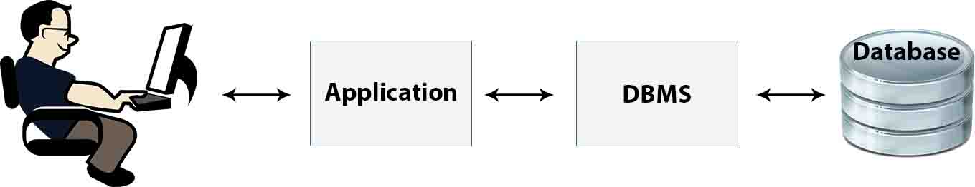
DATABASE- A shared collection of logically related data (and a description of this data), designed to meet the organization needs of an organization.
• The Database Management System (DBMS) - software that enables users to define, create and maintain the database and provides controlled access to the database.

Slide 4
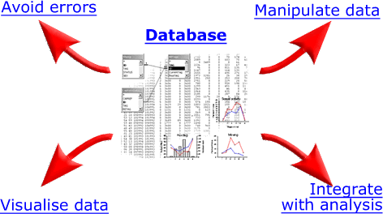
Advantages of database
Sharing of data
• Enforcement of security
• Enforcement of development and maintenance standards
• Reduction of redundancy
• Avoidance of inconsistency across files
• Maintenance of integrity
• Data independence

Slide 5
A producer wants to know….
Which are our lowest/highest margin customers ?
Who are my customers and what products are they buying?
What is the most effective distribution channel?
What product prom- -otions have the biggest impact on revenue?
Which customers are most likely to go to the competition ?
What impact will new products/services
have on revenue and margins?

Slide 6
Data warehouse
A single, complete and consistent store of data obtained from a variety of different sources made available to end users in a what they can understand and use in a business context.
A process of transforming data into information and making it available to users in a timely enough manner to make a difference.
Information
Data

Slide 7
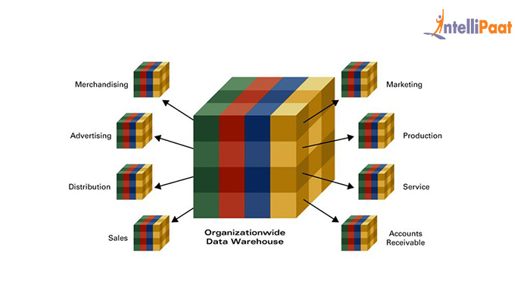
Data Mart
Data mart can be defined as the subset of data warehouse of an organization which is limited to a specific business unit or group of users. It is a subject-oriented database and is also known as High Performance Query Structures (HPQS).

Slide 8
Benefits of Data Marts
Allows the data to be accessed in lesser time
Cost-efficient alternative to the bulky data warehouse
Easy to use as designed according to the needs of specific user group
Fastens the business processes.

Slide 9
Data Mining works with Warehouse Data
Data Warehousing provides the Enterprise with a memory
Data Mining provides the Enterprise with intelligence

Slide 10
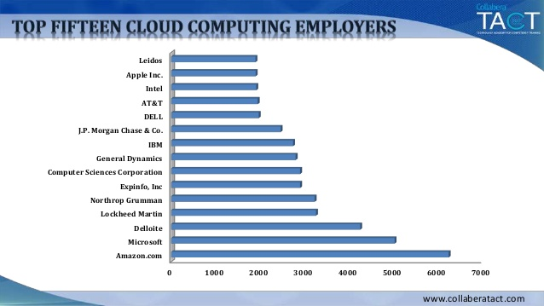
Information Technology

Slide 11
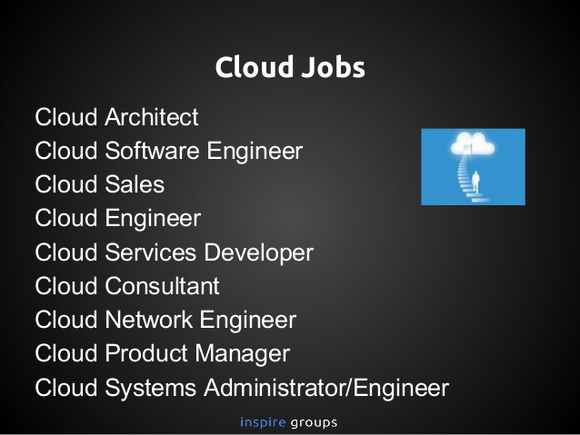
Career Opportunities

Slide 12
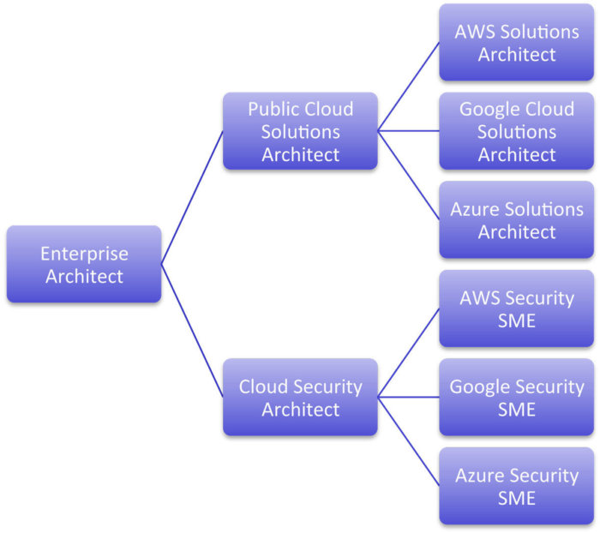
Career Opportunities

Slide 13

The Evolution of Modern Technology

Slide 14
Defining Information
What is Information?
Information is any knowledge that comes to our attention. That could be voice, image, text and video
What is data?
Data is information when dealing with the machine

Slide 15
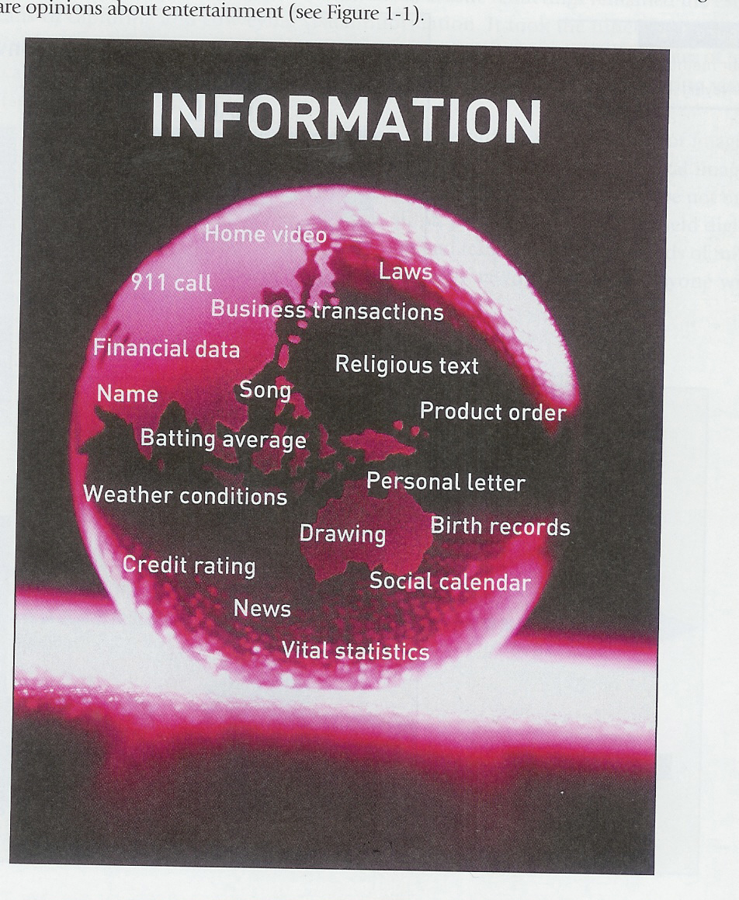
What Counts as information

Slide 16
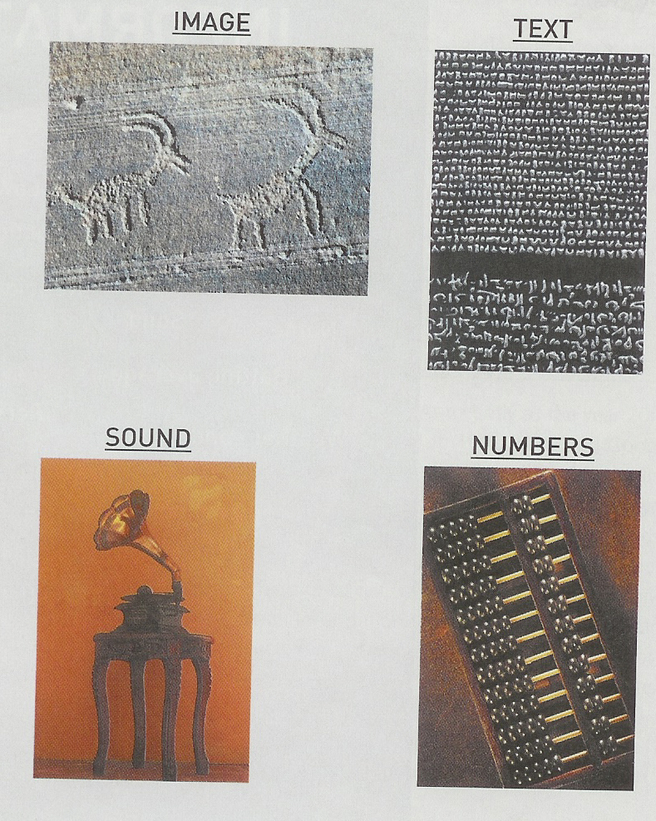
Methods for conveying information

Slide 17
Defining Information Technology
Information Technologies are systems of hardware and/or software that capture, process, exchange, store and/or present information using electrical, magnetic and/or electromagnetic energy.

Slide 18
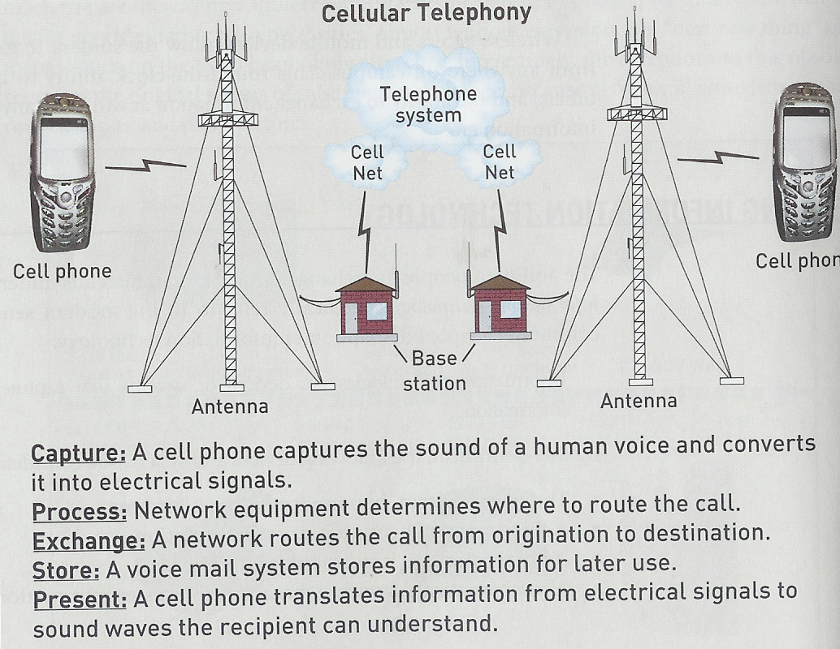
IT Example: Cellular Telephony

Slide 19
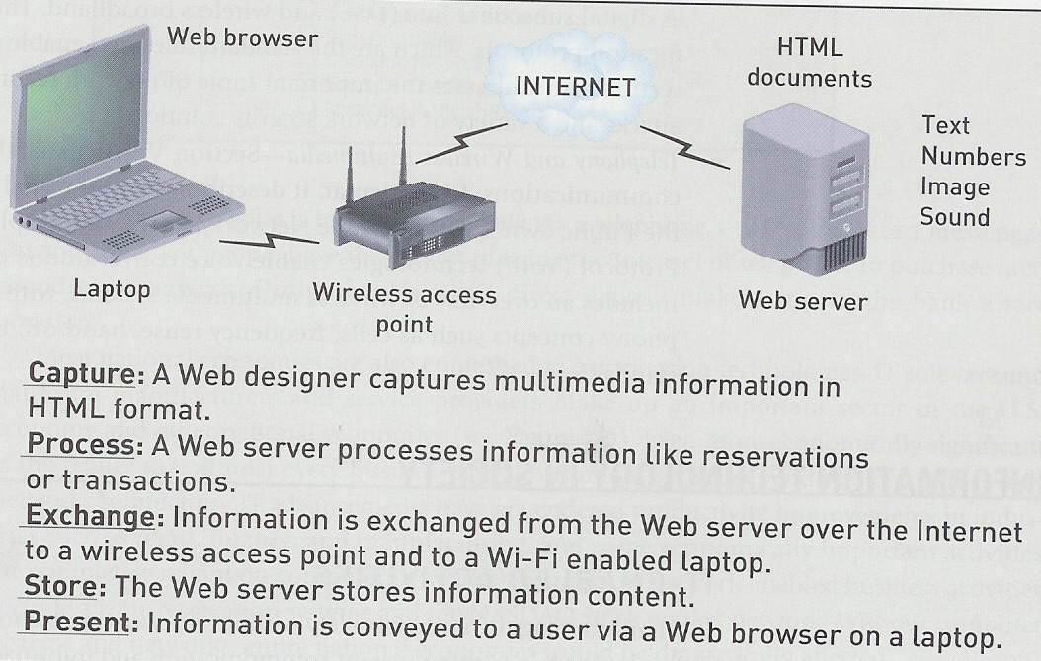
IT Example: Wireless Internet

Slide 20
IT in Society (people)
Personal Communication
Conversations (phone, cell)
Messaging (E-mail, SMS)
Video Coms
Entertainment
Web surfing
Downloading video and audio files
Interactive gaming
Day-to-Day living
Buying airline tecket
Ordering books
Electronic banking/ stock market

Slide 21
IT in Society (business)
Internal Communication
Computer network
Corporate website
Video teleconferencing
Messaging (SMS, email)
Electronic Commerce
Call Centres
Electronic transactions
Online sales
Business operations
Factory operation systems
Databases

Slide 22

IT Revolution in India

Slide 23
Storage Network Technology
Storage networking is the process of linking storage devices together and connecting to other IT networks and provides a centralized repository for data that can be accessed by users and uses high-speed connections to provide fast performance.
Storage networking is used in reference to storage area networks (SANs) which links multiple storage devices and provides block-level storage

Slide 24
Storage Network General Overview

Slide 25
The Storage networking can include direct-attached storage (DAS), network-attached storage (NAS) and storage-area network (SANs).
The interface technologies used in storage networking include Fiber Channel (FC), iSCSI and serial-attached SCSI (SAS).
The benefits of storage networking are improved performance, reliability and availability and also make it easier to back up data for disaster recovery purpose.
Storage networks are often used in parallel to storage management technologies like storage resource management software, virtualization and compression.

Slide 26
Types of Storage
Types of Storage System
– Storage is a technology consisting of components and recording media to retain digital data for the purpose of future usage. It is a core function and fundamental component of computers.
– All computers use a storage hierarchy which puts expensive and small storage options into the CPU. – The volatile technologies are referred to as memory and the slow permanent technologies are referred to as Storage

Slide 27
The computer represents data using binary numeral system. Text, numbers, pictures, audio are converted into string of bits or binary digits having value of 0 or 1.
– Storage in a Computer is measured usually in bytes, Kilobytes(KB), Megabytes(MB), Gigabytes(GB) and presently in Terabytes(TB).

Slide 28
Types of Storage
– Primary Storage: Primary storage is also known as memory, which is directly accessible to the CPU.
RAM, ROM and Cache memory are examples of primary memory.
– Secondary Storage: Secondary storage is also referred to as external memory or auxillary storage and is the one which is not directly accessible by the CPU.
Examples of secondary storage technologies are Flash memory, Floppy disks, magnetic tapes, Optical devices like CD, DVD and also Zip drives

Slide 29

How Computer Networks connect and work

Slide 30
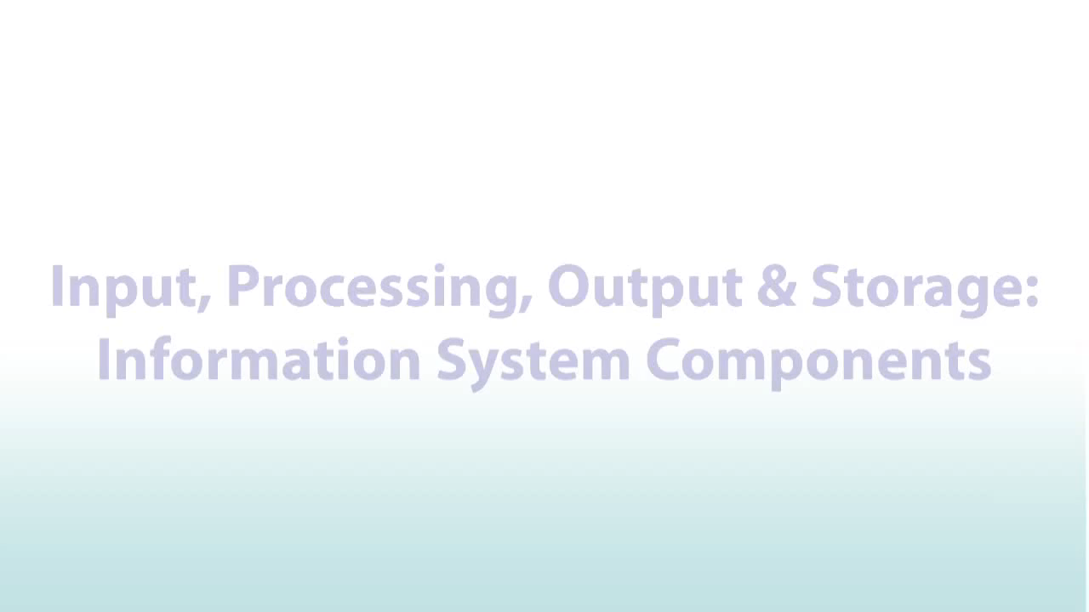
Input/output and Storage

Slide 31

storage

Slide 32
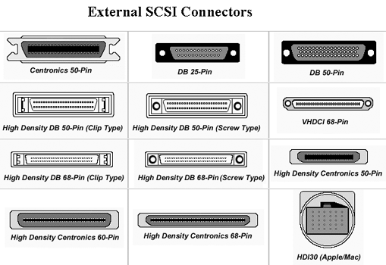
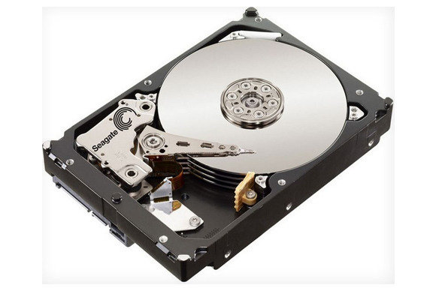
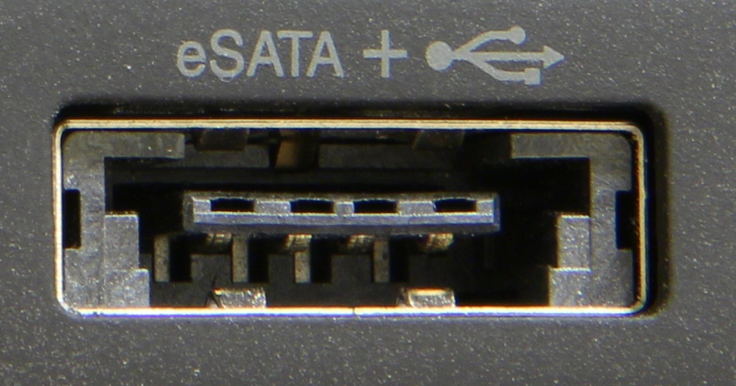
Storage Devices and Technologies
Hard Disk Drive: The most widely used storage device in desktop and Laptop computers is the Hard Disk Drive.
– The hard disk drive consists of magnetic coated disks called “platters” stacked one above other and is written and read by drive heads.
– External disks can be connected using interfaces like SCSI, USB or eSATA.

Slide 33
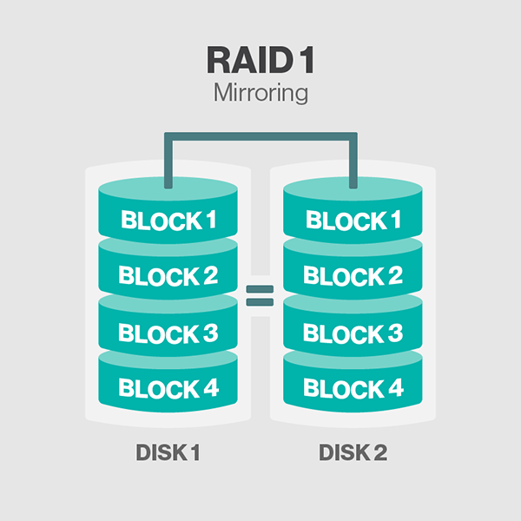
Raid
RAID or Disk Array: The hard disk drives are grouped together using hardware or software and is treated as a single data storage unit.
– The data is recorded across multiple hard disk drives in parallel, increasing the access time significantly.
– The array of multiple hard disk drives which forms the RAID can also be partitioned and assigned with a file system.

Slide 34
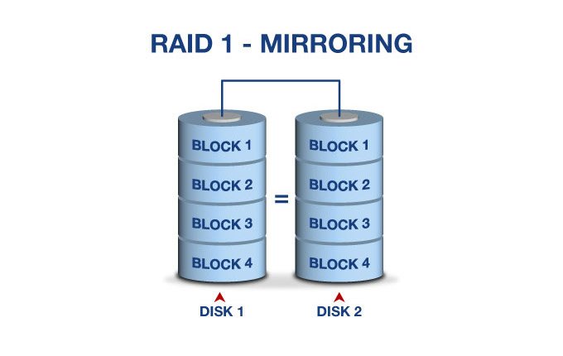
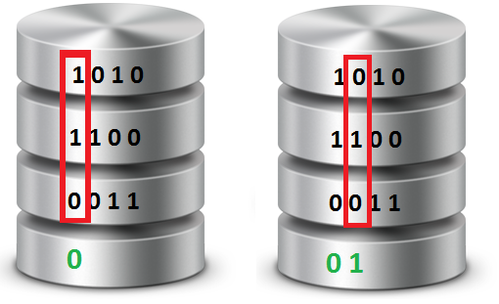
RAID Functions – Striping is the process in which consecutive logical bytes of data is stored per blocks in the consecutive physical disks which forms the array.
– Mirroring is the process in which the data is written to the same block on two or more physical disks in the array.
– Parity Calculation - If there are N number of disks in the RAID array, N-1 consecutive blocks are used for storing data blocks and the Nth block is used for storing the parity

Slide 35
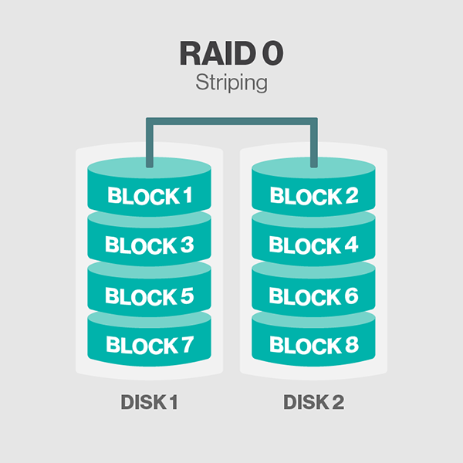
Raid types
RAID 0 is also called as Data Striping with No Parity information. RAID 0 requires a minimum of 2 Hard Disk drives.
– The advantages of RAID 0 is the increase in performance due to the parallelism in the read and write process.
Data striping is the technique of segmenting logically sequential data, such as a file, so that consecutive segments are stored on different physical storage devices.
Striping is useful when a processing device requests data more quickly than a single storage device can provide it. By spreading segments across multiple devices which can be accessed concurrently, total data throughput is increased. It is also a useful method for balancing I/O load across an array of disks. Striping is used across disk drives in redundant array of independent disks (RAID) storage, network interface controllers, different computers in clustered file systems and grid-oriented storage, and RAM in some systems.

Slide 36
Raid 0
RAID 0 is also called as Data Striping with No Parity information. RAID 0 requires a minimum of 2 Hard Disk drives.
– The advantages of RAID 0 is the increase in performance due to the parallelism in the read and write process.

Slide 37
Raid 1
RAID 1 is called as Data Mirroring. RAID 1 requires a minimum of two or more Hard Disk drives.
– The advantages of RAID 1 are good performance in the read operation as the data is read parallely from several disks.

Slide 38
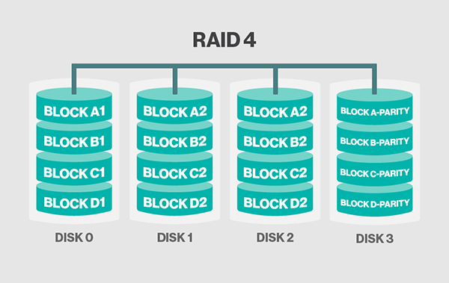
RAID 4
– RAID 4 is a process of independent, whole Block Access in which the data is stored across the number of disks (N-1) and the other disk acts as a dedicated Parity Drive which stores the parity information.

Slide 39
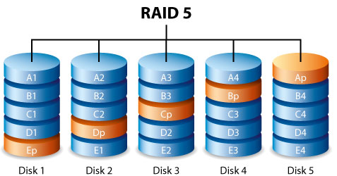
RAID 5
RAID 5 – RAID 5 is the process identical to the RAID 4, but the parity is striped across multiple drives in the array.
– RAID 5 requires a minimum of 3 hard disk drives for its configuration.
– The advantage of RAID 5 is the good read performance due to the parallelism like RAID 0.

Slide 40
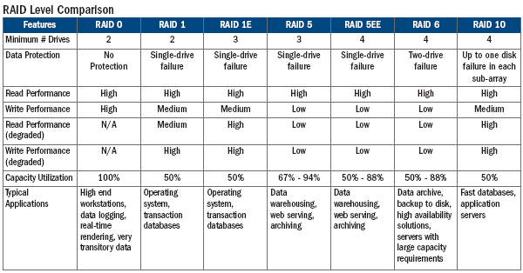
Raid Comparison

Slide 41
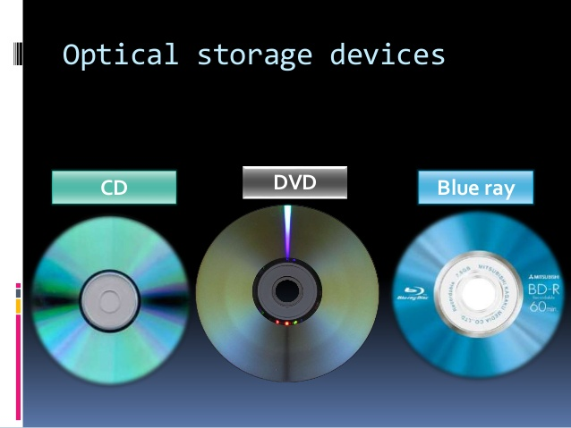
Optical Storage
Optical Storage – Optical Storage is one of the low-cost and reliable storage media used in personal computers for incremental data archiving.
– Optical storage are available in any one of the three basic formats like Compact Disk (CD), Digital versatile disk (DVD) and Blue-ray disk (BD).
– The capacities and speeds of the optical discs are lower comparing with the Hard Disk Drives and Tape drives.

Slide 42
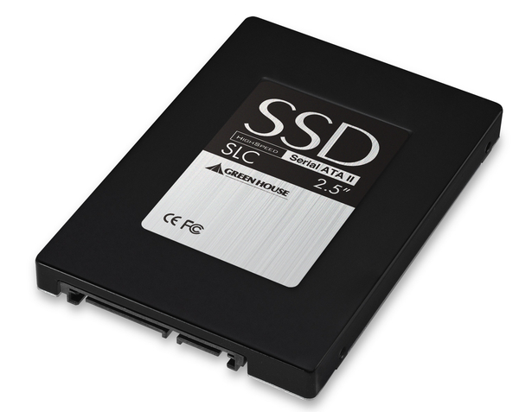
Solid State Drives
Solid State Drives – Solid state drives do not contain any moving parts like the magnetic drives.
– Solid state drives are also known as flash memory, thumb drives, USB flash drives, Memory Stick, Secure digital cards.
– The SSDs are relatively expensive when compared to the other types for their low capacity, but are very convenient for backing up the data.

Slide 43
FC-AL
FC-AL (Fibre Channel Arbitrated Loop) – FC-AL is a fibre channel topology used to connect devices using a loop topology, similar to a token ring network.
– A token is used to prevent data from colliding when two or more streams are sent at the same time. FC-AL passes data using one-way loop technique.
– FC-AL technology eliminates the expensive fibre channel switches and allows several servers and storage devices to be connected.

